Slide 1
Week 4
Denial of service and Social Engineering

Slide 2
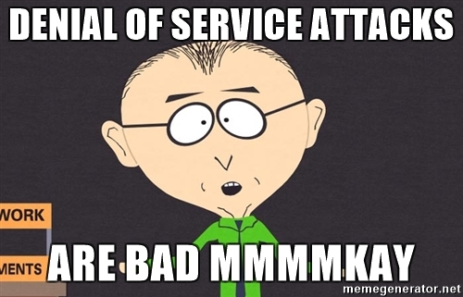
Denial of Service
Attack on Availability (CIA)
Example attacks
  Packet flooding
  Smurf attack (ICMP)
  Pulsing zombies
  PDoS (PhlashDance)

Slide 3
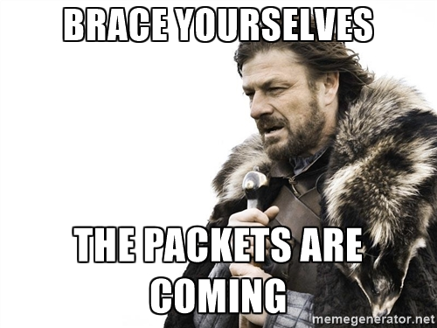
Distributed Denial of Service (DDOS)
Application layer DDOS (OSI model)
Advanced Persistent DOS by an APT
Denial of Service as a service
  Known as Booters or Stressers

Slide 4
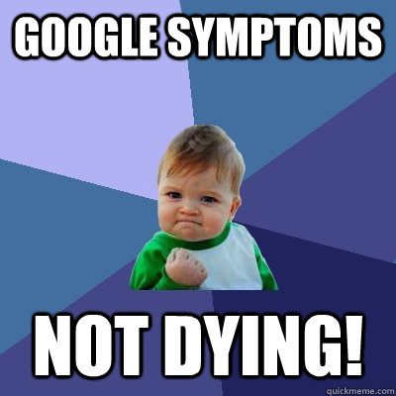
Symptoms?
Slow networks
Unavailable site(s)
No internet service

Slide 5
Oh noes! What to do?
3rd party services specially designed for DOS and DDOS
Packet filtering
  Ingress
  Egress
Turn off unused ports
Update! Patch!
Watch network traffic
Watch the News
Harden your machines

Slide 6

Legality
Denial of Service is illegal
US says federal crime under Computer Fraud and Abuse act
Anonymous wants DDOS recognized as legal form of protest

Slide 7
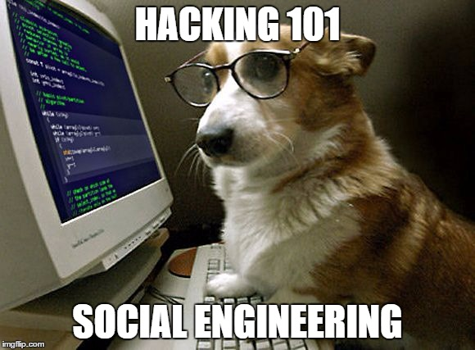
Social Engineering
Targeted vs non-specific

Slide 8
Activity!
Observation Games
Don’t be creepy!

Slide 9
Social Engineering Vectors
Vectors
  Email
  Phone
  In Person
  Social Media

Slide 10
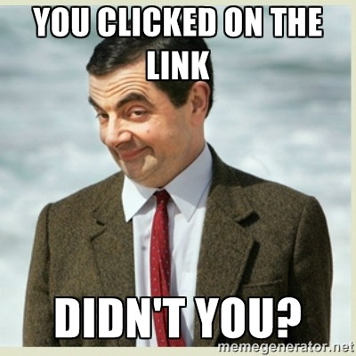
Social Engineering Types
Phishing
Spearphishing
Vishing
SMIshing
Pretexting
Typosquatting

Slide 11
Deepfakes and AI-Powered Social Engineering
Deepfake video calls: in 2024, an employee at engineering firm Arup sent $25.6 million after a video call where everyone else on the call was a deepfake
  Source: CNN
Voice cloning makes vishing calls sound like your boss or a family member
Canvas (2026): attackers used voice phishing to steal data on over 30 million students and staff
Instagram (2026): attackers abused Meta's AI support chatbot to reset passwords, and thousands of accounts were hijacked
  Source: TechCrunch
Defense: check through a second channel, call back on a number you already know, and agree on a code word with family

Slide 12
How does it work?
Recon
Setting the environment
Exfiltration

Slide 13
Activity
Manipulation activity
Don’t be creepy!
Looking a specific way
Using only “designated” doors

Slide 14

Inoculation: Personal
Awareness
Research

Slide 15

Inoculation: Businesses
Training
Awareness
Scripting responses
Test! Test! Test!

